Slide 1
School of Geography and Geology
McMaster University
Advanced Topics in Spatial Statistics
Point Pattern Analysis I & II

Slide 2
This session:
Point Pattern Analysis I
  Definitions
  First and Second Order Properties
  Visualizing Point Patterns
  Exploring Point Patterns
    Quadrat counts
    Quadrat Analysis
Definitions Order Properties Visualization Quadrat Counts Quadrat Analysis

Slide 3
Definitions
Region
Point
Event
Attributes
Patterns
  Random
  Clustered
  Dispersed/Regular
Definitions Order Properties Visualization Quadrat Counts Quadrat Analysis

Slide 4

Definitions: Region
Region (R) – Specific area over the surface of the earth that is of interest
Definitions Order Properties Visualization Quadrat Counts Quadrat Analysis

Slide 5
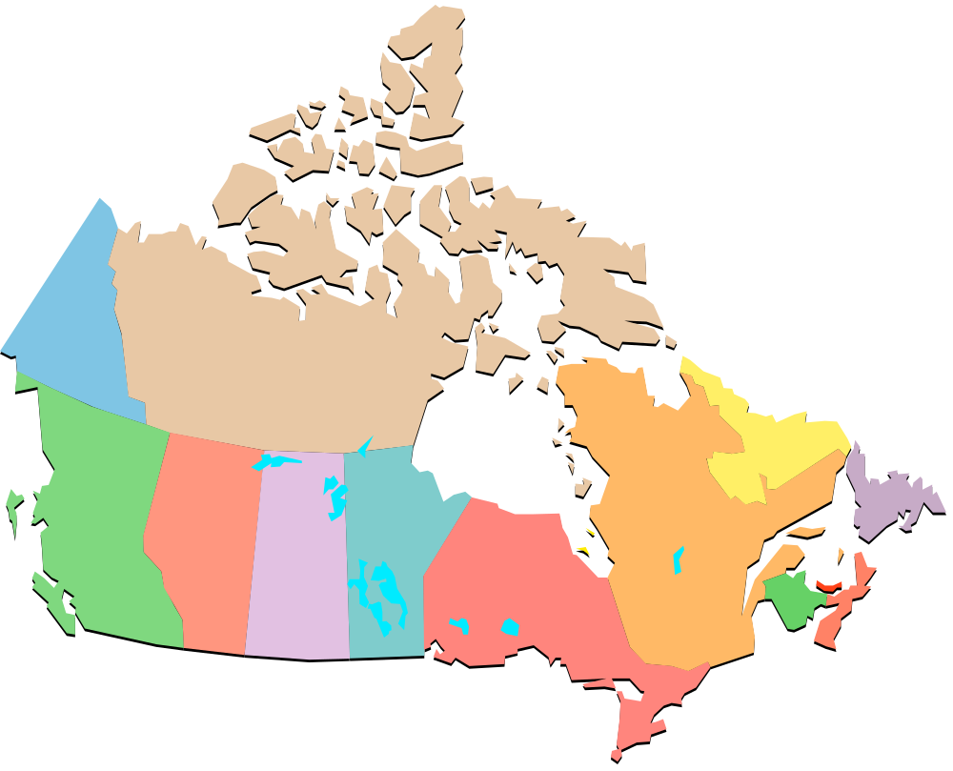
Definitions: Region
Examples of regions - Continent
Definitions Order Properties Visualization Quadrat Counts Quadrat Analysis

Slide 6
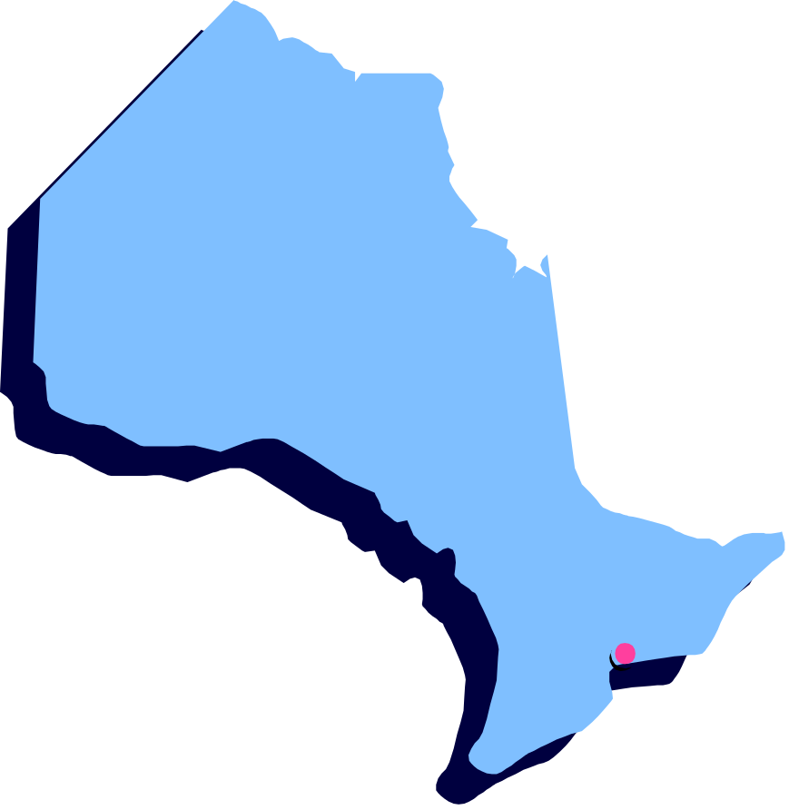
Definitions: Region
Examples of regions - Province
Definitions Order Properties Visualization Quadrat Counts Quadrat Analysis

Slide 7

Definitions: Region
Examples of regions
  City
Definitions Order Properties Visualization Quadrat Counts Quadrat Analysis

Slide 8

Definitions: Region
Examples of regions
  Land plot
Definitions Order Properties Visualization Quadrat Counts Quadrat Analysis

Slide 9
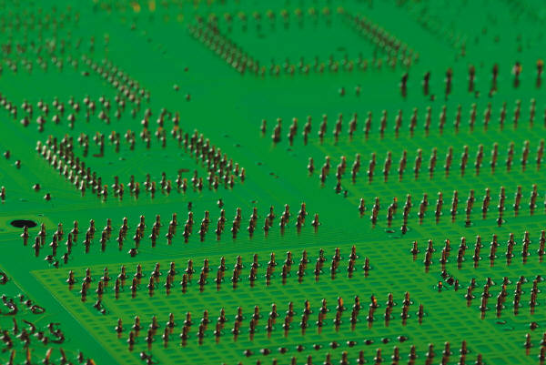
Definitions: Region
Examples of regions
  Computer chip
Definitions Order Properties Visualization Quadrat Counts Quadrat Analysis

Slide 10
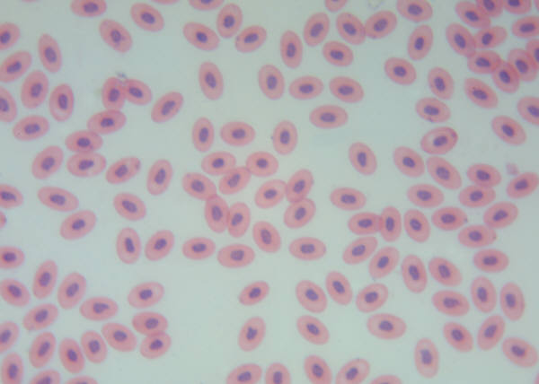
Definitions: Region
Examples of regions
  Section of tissue
Definitions Order Properties Visualization Quadrat Counts Quadrat Analysis

Slide 11
Definitions: Region
Regular region
Irregular region
Definitions Order Properties Visualization Quadrat Counts Quadrat Analysis

Slide 12
Definitions: Point
Point – An arbitrary location in region R
Definitions Order Properties Visualization Quadrat Counts Quadrat Analysis

Slide 13
Definitions: Event
Event – An “interesting” occurrence in region R
s=(s1,s2)
“x” and “y” coordinates
Definitions Order Properties Visualization Quadrat Counts Quadrat Analysis

Slide 14
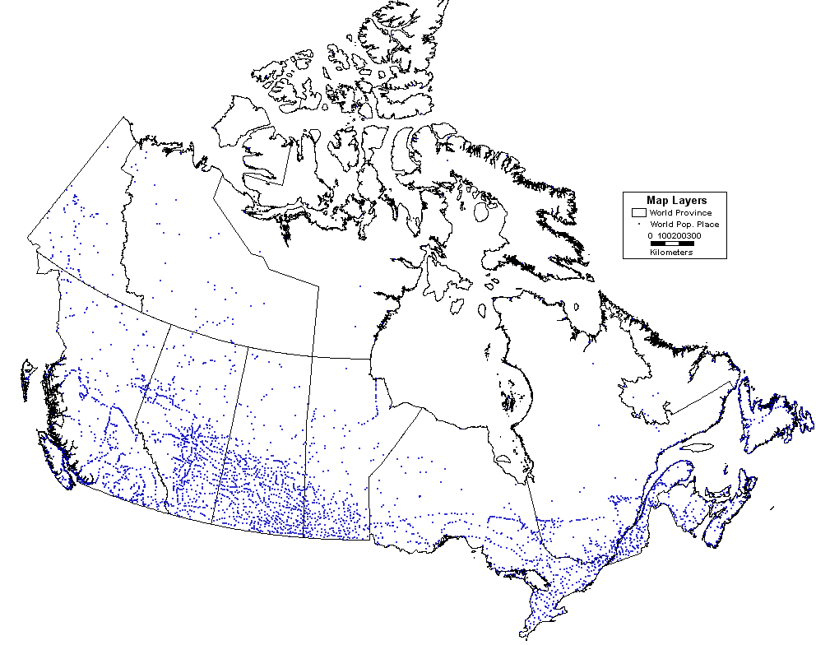
Definitions: Event – Examples
Definitions Order Properties Visualization Quadrat Counts Quadrat Analysis

Slide 15
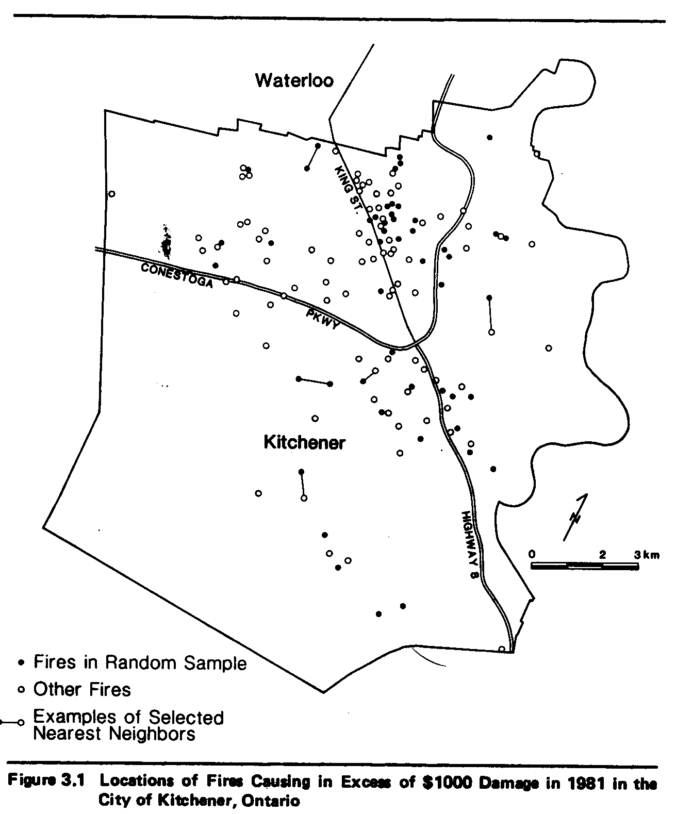
Definitions: Event – Examples
Note:
What about the underlying population?
Definitions Order Properties Visualization Quadrat Counts Quadrat Analysis

Slide 16
Definitions: Event – Examples
Event – Further examples
Definitions Order Properties Visualization Quadrat Counts Quadrat Analysis

Slide 17
Definitions: Attributes
s₁, s₂: the “x” and “y” coordinates of the event
Other values attached to event
  Type of occurrence
    Type of building
    Tree species
    …
  Time of occurrence
  Other characteristics
    Depth of borehole
    Age
    …
Definitions Order Properties Visualization Quadrat Counts Quadrat Analysis

Slide 18
Definitions: Patterns
Definitions Order Properties Visualization Quadrat Counts Quadrat Analysis

Slide 19
Definitions: Patterns
Definitions Order Properties Visualization Quadrat Counts Quadrat Analysis

Slide 20
Definitions: Patterns
Definitions Order Properties Visualization Quadrat Counts Quadrat Analysis

Slide 21
Definitions: Population
Mapped point pattern – A complete map of events in R
Definitions Order Properties Visualization Quadrat Counts Quadrat Analysis

Slide 22
Definitions: Sample
Sampled point pattern – Some events in R have not been recorded
Recorded
event
Unrecorded
event
Definitions Order Properties Visualization Quadrat Counts Quadrat Analysis

Slide 23
Definitions: Sample
Limitations - Example
Definitions Order Properties Visualization Quadrat Counts Quadrat Analysis

Slide 24
Definitions: Edge Effects
Edge Effects
Definitions Order Properties Visualization Quadrat Counts Quadrat Analysis

Slide 25
Definitions: Edge Effects
Possible Solution – Creating a torus
Definitions Order Properties Visualization Quadrat Counts Quadrat Analysis

Slide 26
Definitions: Edge Effects
Possible Solution – Guard Area
Definitions Order Properties Visualization Quadrat Counts Quadrat Analysis

Slide 27
First & Second Order Properties
Number of Events per Unit Area
Sub-area A
Definitions Order Properties Visualization Quadrat Counts Quadrat Analysis

Slide 28
First & Second Order Properties
Number of Events per Unit Area
Y(A_{i}): Number of events per unit area i
E[Y(A)]: Mean number of events per unit area
COV[Y(A₁), Y(A₂)]: Covariance between A₁ and A₂
Definitions Order Properties Visualization Quadrat Counts Quadrat Analysis

Slide 29
First & Second Order Properties
Number of Events per Unit Area
Depends on the number of events in R and the size of A
Definitions Order Properties Visualization Quadrat Counts Quadrat Analysis

Slide 30
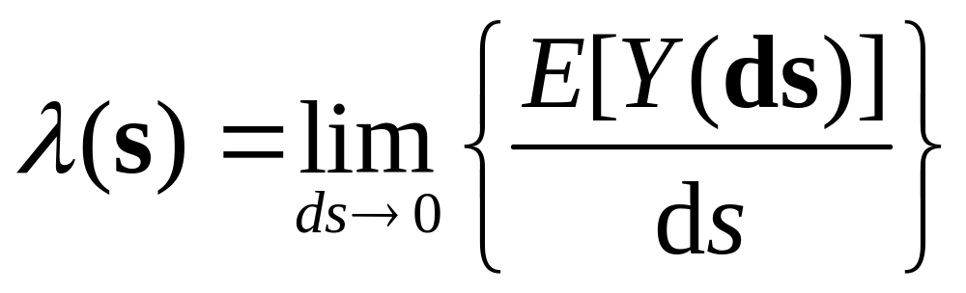
First order properties
Intensity – Mean number of events per unit area at point s
Stationary process: λ(s) is a constant → λ
Definitions Order Properties Visualization Quadrat Counts Quadrat Analysis

Slide 31
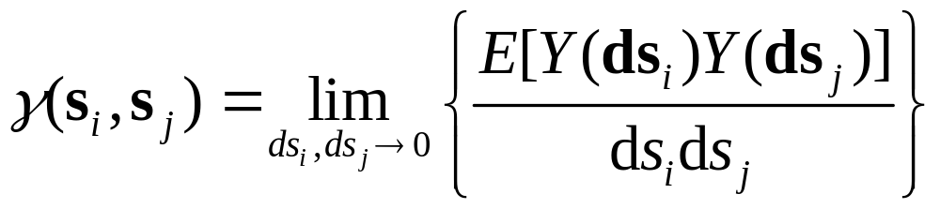
Second order properties
Second Order Intensity
Stationary, isotropic process: γ(s) depends on distance only
Definitions Order Properties Visualization Quadrat Counts Quadrat Analysis

Slide 32
Visualizing Point Patterns
Dot Map
Definitions Order Properties Visualization Quadrat Counts Quadrat Analysis

Slide 33
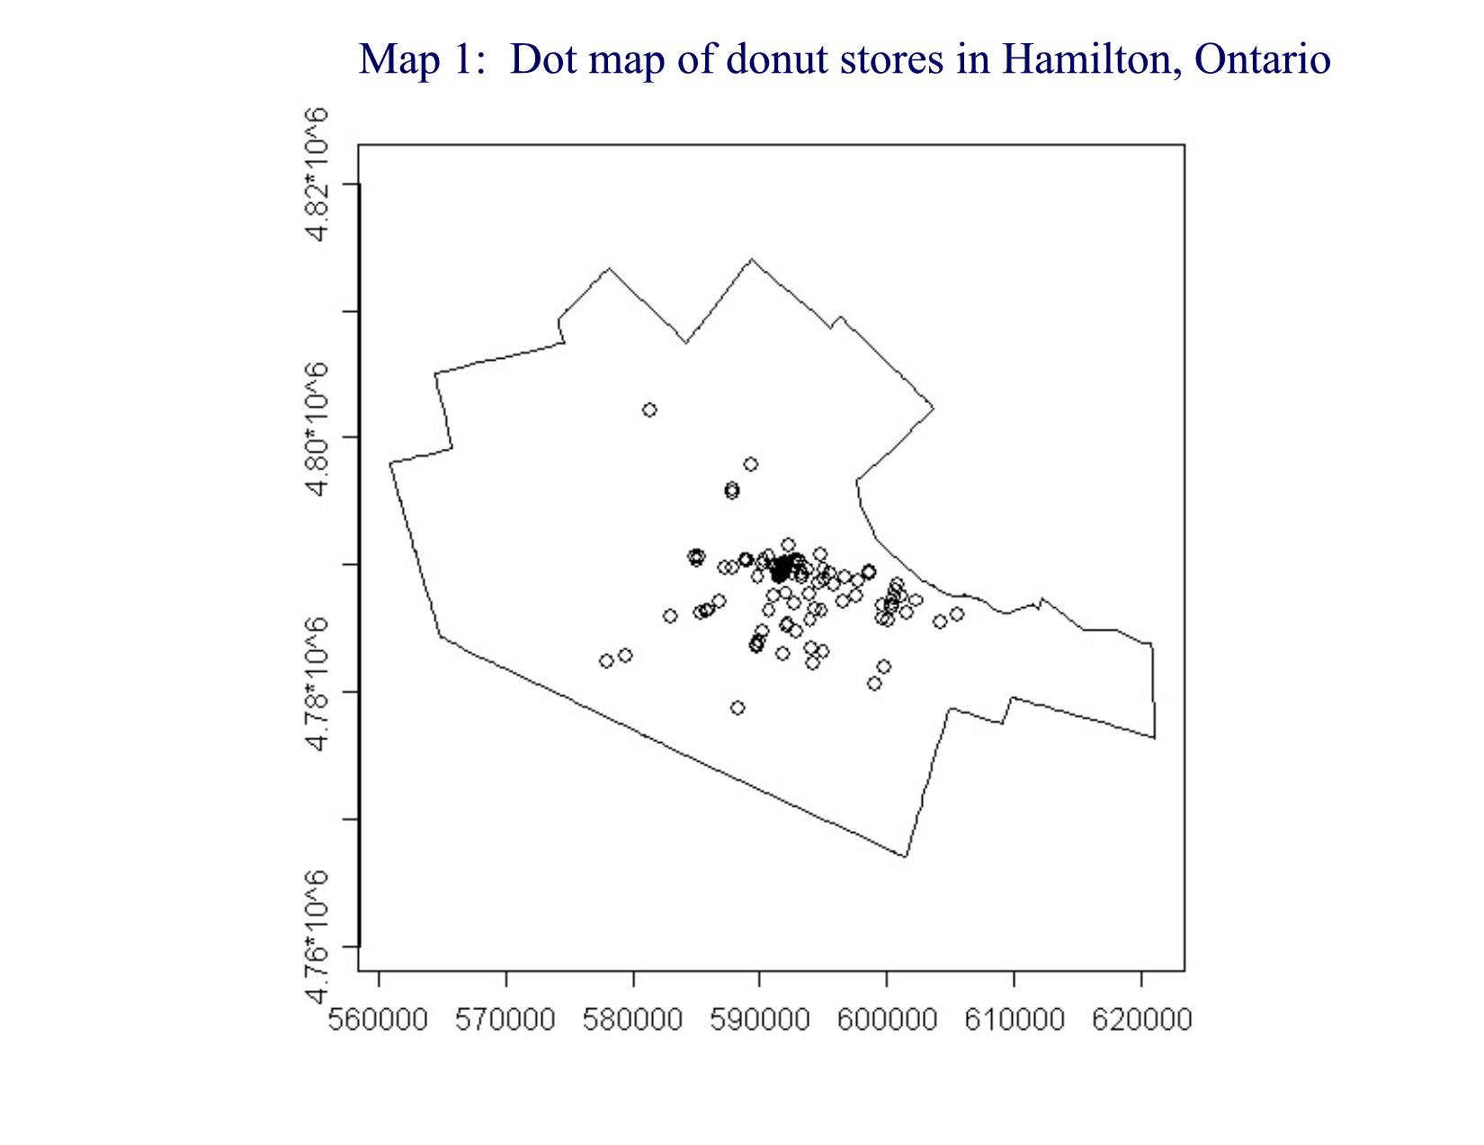
Example: Shops in Hamilton, ON
Definitions Order Properties Visualization Quadrat Counts Quadrat Analysis

Slide 34
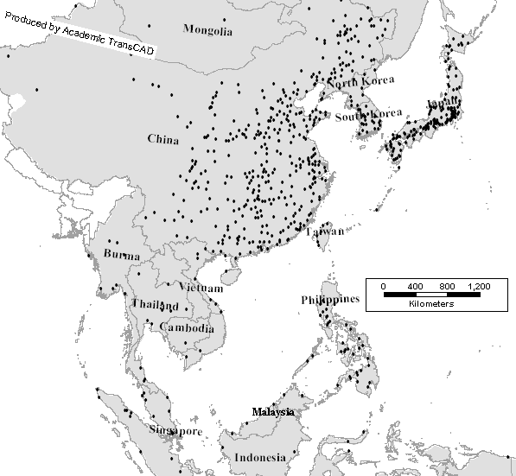
Example: Populated Places Asia
Definitions Order Properties Visualization Quadrat Counts Quadrat Analysis

Slide 35
Visualizing Point Patterns
Dot map is geographical analog of scatterplot

Slide 36
Visualizing Point Patterns
Dot Map with Attributes
Definitions Order Properties Visualization Quadrat Counts Quadrat Analysis

Slide 37
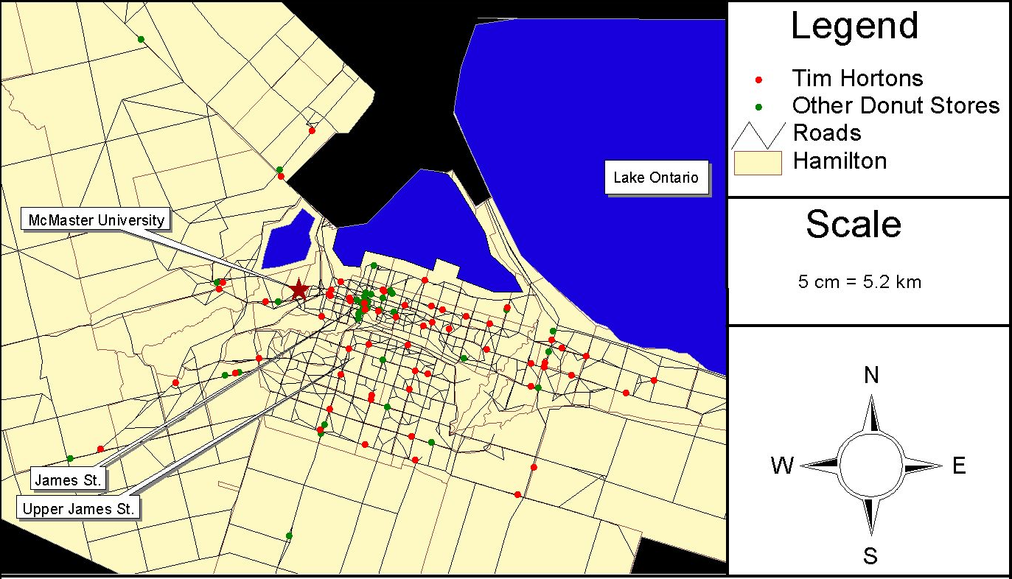
Example: Shops in Hamilton, ON
Definitions Order Properties Visualization Quadrat Counts Quadrat Analysis

Slide 38
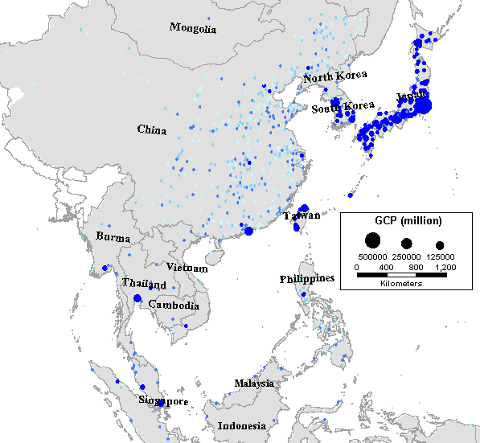
Example: Cities in Eastern Asia
Dot Map with Attributes
Definitions Order Properties Visualization Quadrat Counts Quadrat Analysis

Slide 39
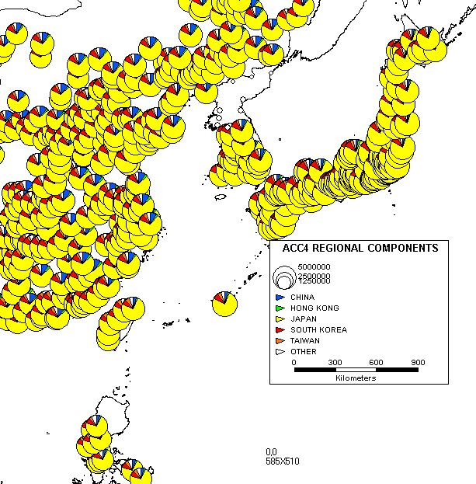
Example: Cities in Eastern Asia
Dot Map with Attributes
Definitions Order Properties Visualization Quadrat Counts Quadrat Analysis

Slide 40
Visualizing Point Patterns
Dot Map with Attributes
  Represent underlying population
Definitions Order Properties Visualization Quadrat Counts Quadrat Analysis

Slide 41
Exploring Point Patterns
Methods
  Quadrat Counts/Analysis
  Kernel Estimation
Definitions Order Properties Visualization Quadrat Counts Quadrat Analysis

Slide 42
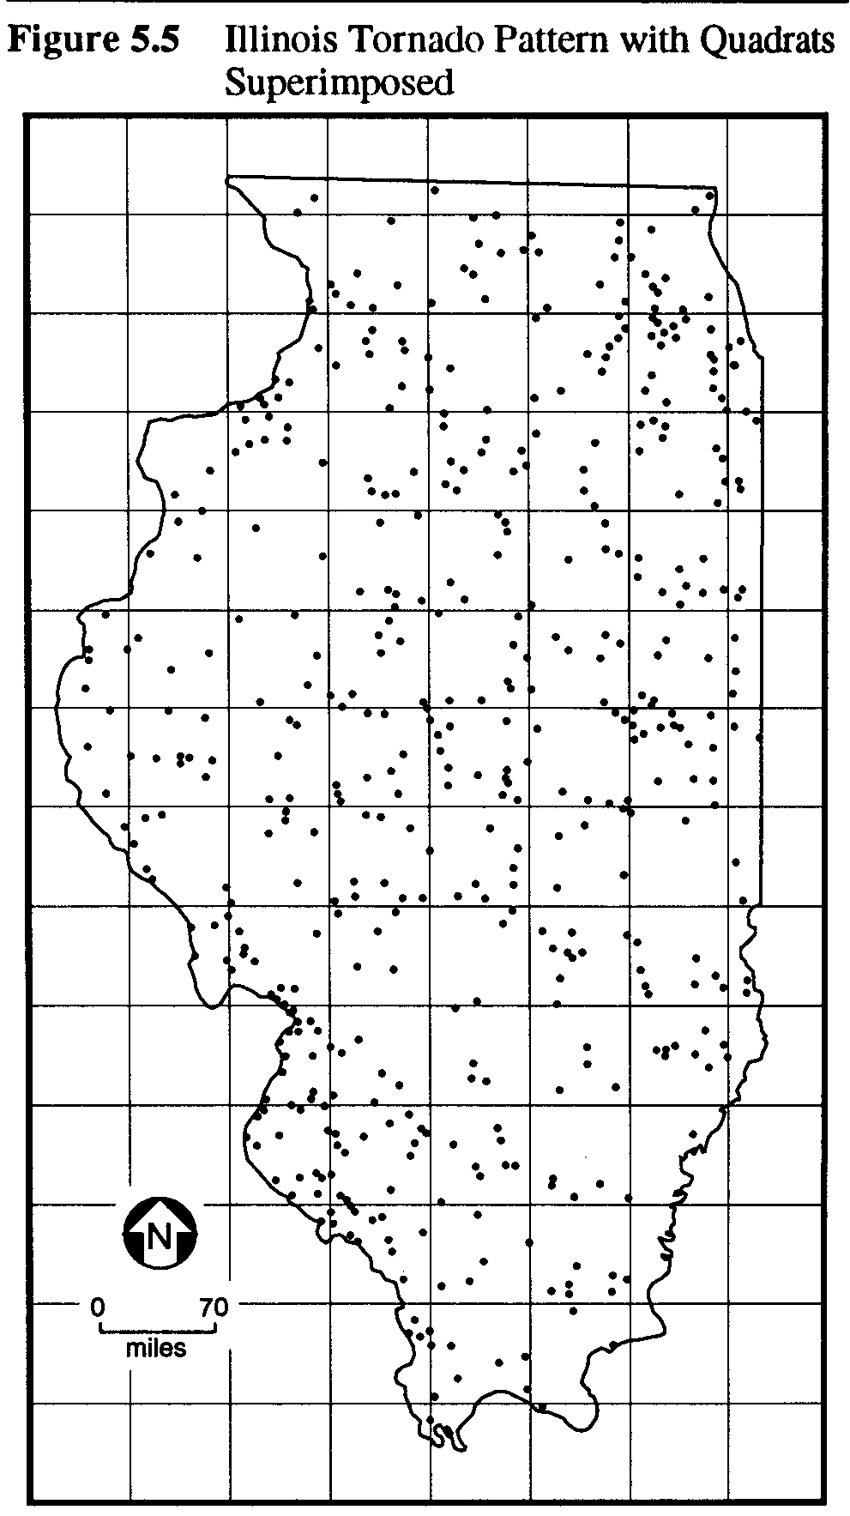
Quadrat Counts
Definitions Order Properties Visualization Quadrat Counts Quadrat Analysis

Slide 43
Quadrat Counts – Moving Window
Geographical analog of histogram
High
Intensity
Low
Intensity
Definitions Order Properties Visualization Quadrat Counts Quadrat Analysis

Slide 44
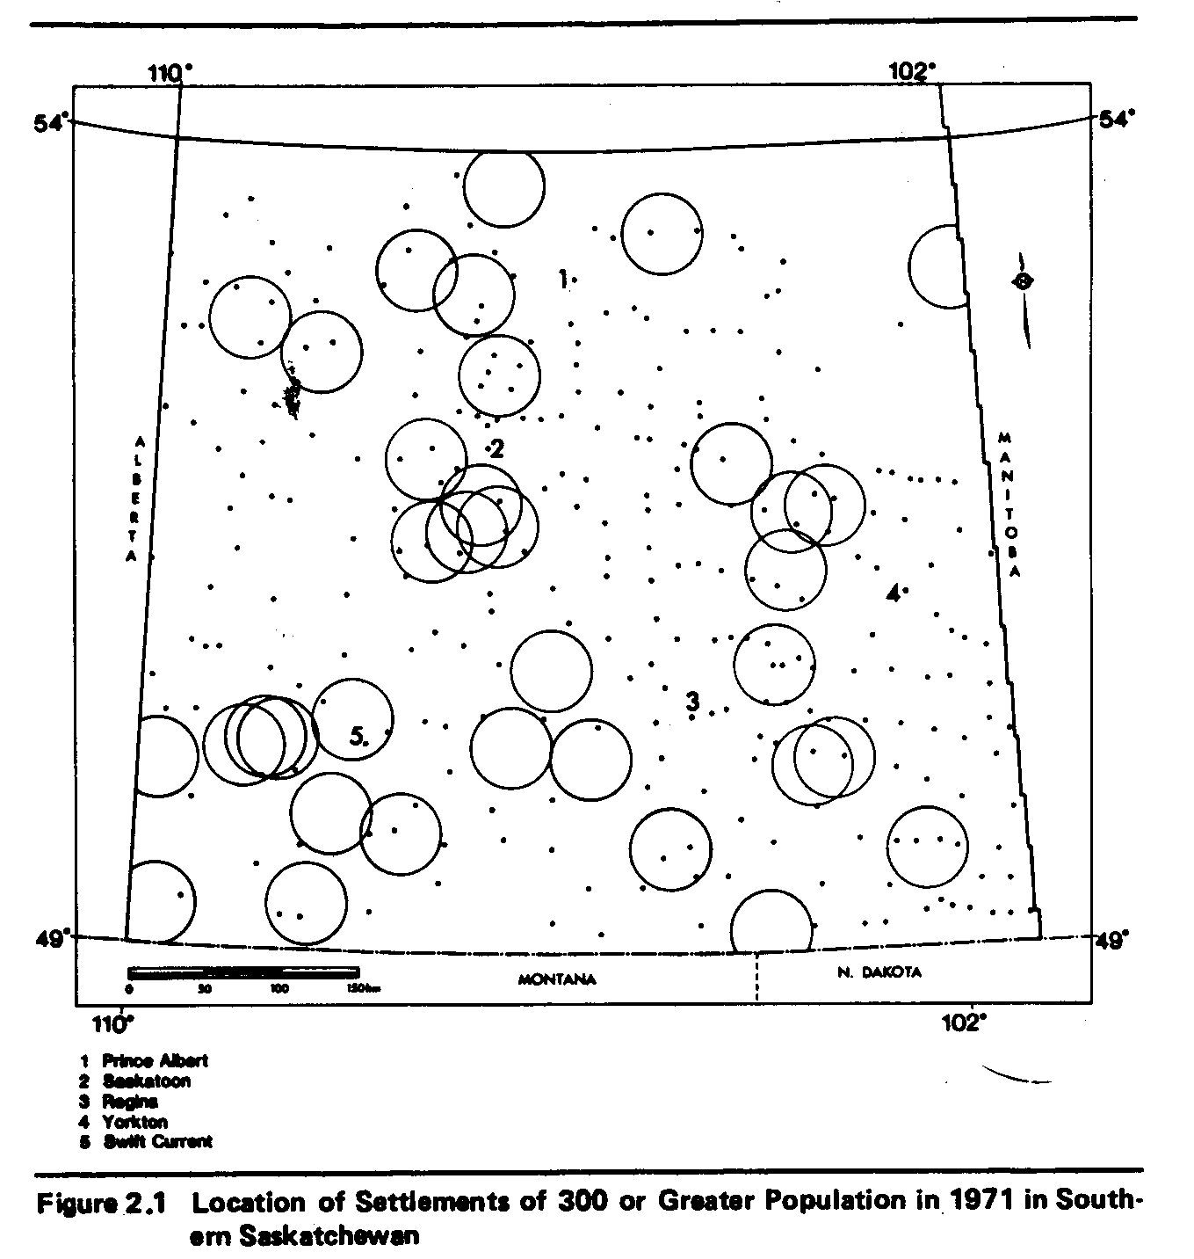
Quadrat Counts
Definitions Order Properties Visualization Quadrat Counts Quadrat Analysis

Slide 45
Quadrat Counts – Moving Window
Definitions Order Properties Visualization Quadrat Counts Quadrat Analysis

Slide 46
Quadrat Counts – Moving Window
Smooth variation of intensity λ(s)
(Good)
High
Intensity
Low
Intensity
Definitions Order Properties Visualization Quadrat Counts Quadrat Analysis

Slide 47
Quadrat Counts – Moving Window
Relative location of points within window?
Definitions Order Properties Visualization Quadrat Counts Quadrat Analysis

Slide 48
Quadrat Counts – Moving Window
Size of window?
Definitions Order Properties Visualization Quadrat Counts Quadrat Analysis

Slide 49
Quadrat Counts – Moving Window
Large window
Small window
Definitions Order Properties Visualization Quadrat Counts Quadrat Analysis

Slide 50
Quadrat Analysis
Based on the frequency of events occurring in various parts of the region
Definitions Order Properties Visualization Quadrat Counts Quadrat Analysis

Slide 51
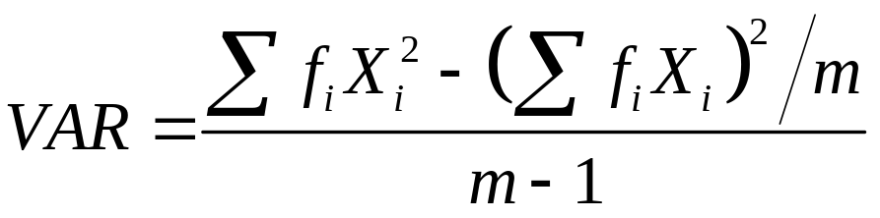
Quadrat Analysis
Mean cell frequency
  MEAN = # of events (n)/# of cells (m)
Variance of the cell frequencies
Variance–mean ratio
  VMR = VAR / MEAN
Definitions Order Properties Visualization Quadrat Counts Quadrat Analysis

Slide 52
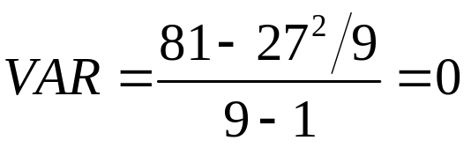
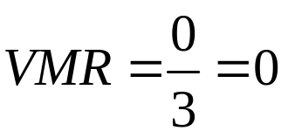
Case 1
# of Events X | X² | # of Cells with X Events (f) | fX | fX²
X=0 | 0 | 0 | 0 | 0
X=1 | 1 | 0 | 0 | 0
X=2 | 4 | 0 | 0 | 0
X=3 | 9 | 9 | 27 | 81
X=4 | 16 | 0 | 0 | 0
X=5 | 25 | 0 | 0 | 0
 |  | Sum= | 27 | 81
MEAN = 27/9 = 3
Definitions Order Properties Visualization Quadrat Counts Quadrat Analysis

Slide 53
Case 2
Definitions Order Properties Visualization Quadrat Counts Quadrat Analysis
Notes:
Case 2
# of Events X X2 # of Cells with X Events (f) fX fX2
X=0 0 3 0 0
X=1 1 2 2 2
X=2 4 0 0 0
X=3 9 1 3 9
X=4 16 0 0 0
X=5 25 0 0 0
X=6 36 0 0 0
X=7 49 2 14 98
X=8 64 1 8 64
Sum= 27 173
m=9, n=27
MEAN=3
VAR=(173-27^2/9)/8=11.5
VMR=11.5/3=3.83

Slide 54
Case 3
Definitions Order Properties Visualization Quadrat Counts Quadrat Analysis
Notes:
Case 3
# of Events X X2 # of Cells with X Events (f) fX fX2
X=0 0 1 0 0
X=1 1 0 0 0
X=2 4 2 4 8
X=3 9 3 9 27
X=4 16 1 4 16
X=5 25 2 10 50
Sum= 27 101
m=9, n=27
MEAN=3
VAR=(101-27^2/9)/8=2.5
VMR=2.5/3=0.833

Slide 55
Quadrat Analysis
Variance-mean ratio
  VMR < 1: The pattern is more dispersed than random
  VMR > 1: The pattern is more clustered than random
  VMR = 1: The pattern is random
Definitions Order Properties Visualization Quadrat Counts Quadrat Analysis

Slide 56
Next…
Kernel estimation
Second order properties
Nearest neighbor analysis
K Functions

